Slide 1
AVERAGE EFFECT
Mean centred lyric modification covariate
22 subjects

Slide 2
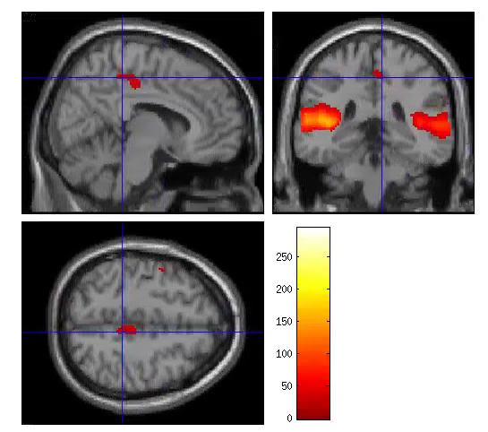
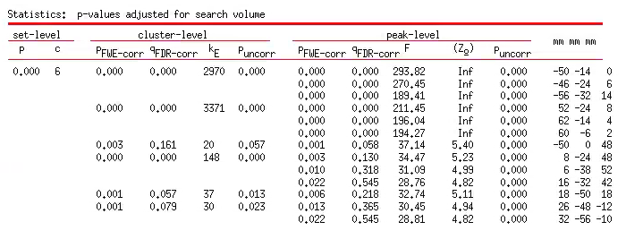
S1TBL_lyrmod_mean_22subj
Extent threshold = 19
P<0.05 FWE cor
Significant effect of lyrmod in ROI1, 2, and 4
(ROI3 sig at 0.1 level)
ROI1
ROI2
ROI3
ROI4

Slide 3
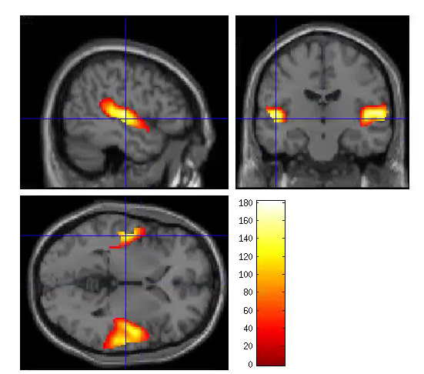
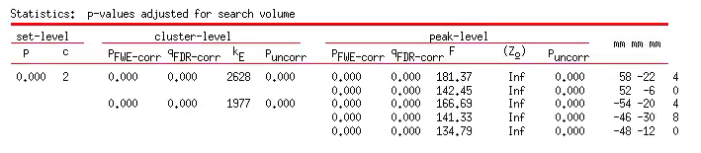
S2TBL_lyrmod_mean_22subj
Extent threshold = 22
P<0.05 FWE cor
ROI1
ROI2

